Slide 1
mLIMS in Our Lab: Smarter Mouse Colony Management
Focused on efficiency, cost savings, and genotype-driven

Slide 2
Why mLIMS?
Individual colonies = duplicated cages, lost info
No consistent strategy for keeping only desired genotypes
We wants:
Lower cage costs
Faster genotyping decisions
Streamlined planning across the lab

Slide 3
Lab-Specific Benefits
Shared visibility of all colonies, no overlap
Genotype-driven culling to avoid wasting cages
Reminders for breeding, weaning, genotyping
Flexible: each member manages their own colony within one platform

Slide 4
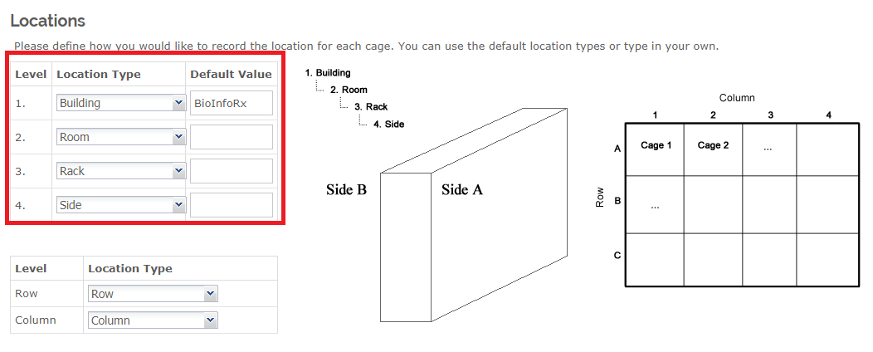
Feature Cage map

Slide 5
Money-Saving Benefit
Track colony-wide cage usage trends
Identify animals not contributing to research
Better resource planning via reports
Built-in IACUC tracking and compliance alerts

Slide 6
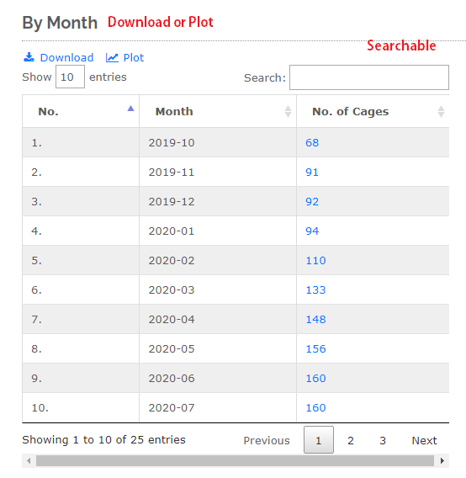
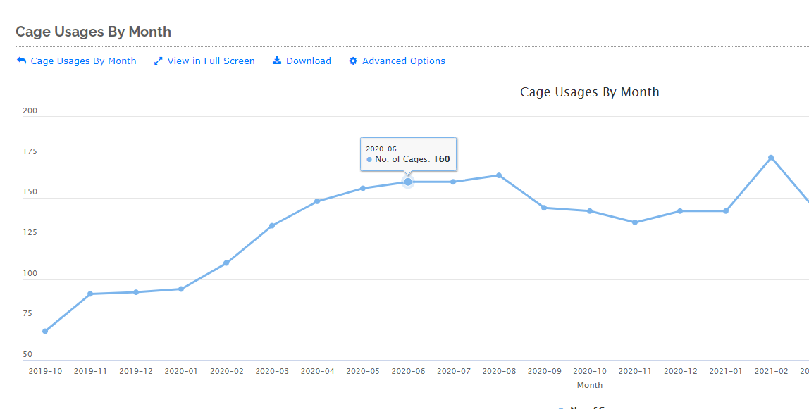
Feature Cage usage report

Slide 7
What’s Next
Each person gets their colony set up
I’ll support setup and walkthroughs 1-on-1

